Slide 1
pseudocode

Slide 2
Algorithm representation
There are two ways to represent an algorithm:
Flowchart – graphical
Pseudcode – textual
You will be required to produce both in the exam

Slide 3
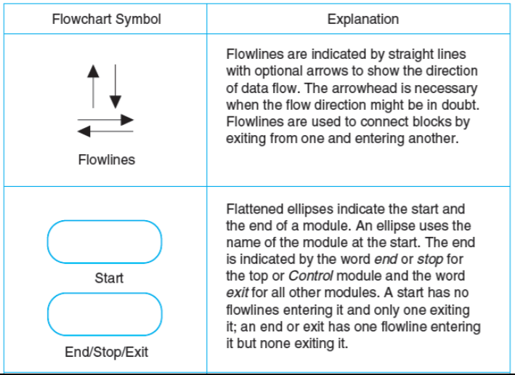
flowcharts

Slide 4
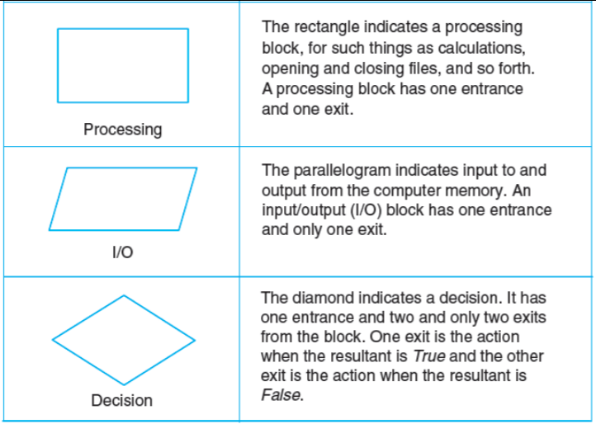

Slide 5
Pseudocode
Pseudocode is:
Not actual programming code.
Not written in a programming language.
Commonly written using structured English.
Pseudocode is then passed on to programmers and written in a particular language.

Slide 6
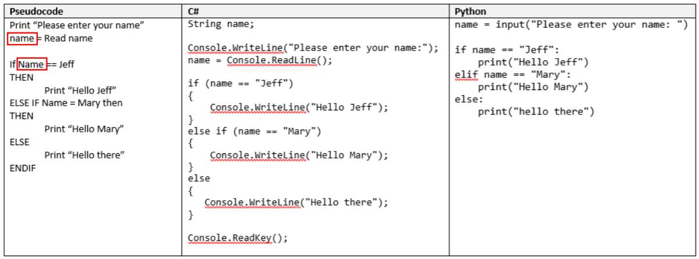
Pseudocode Example

Slide 7
pseudocode
Think of pseudocode as a ‘halfway house’…
…halfway between plain English and a programming language.
‘Psuedo’ is from the Greek language…
… used to describe something that appears to be one thing, but is in fact something else.

Slide 8
pseudocode
Pseudocode looks to be computer code, but…
… it is actually a set of instructions written in structured English.
Here ends the English Language lesson.
There is a T-Level pseudocode specification in SharePoint

Slide 9
Full annotated code
camelCase or snake_case
var1, var2, num, num2, a, b, tmp
Function names
Make the code big enough to read – 14pt
No wider than 80 – 120 characters
Comments – why, not what

Slide 10
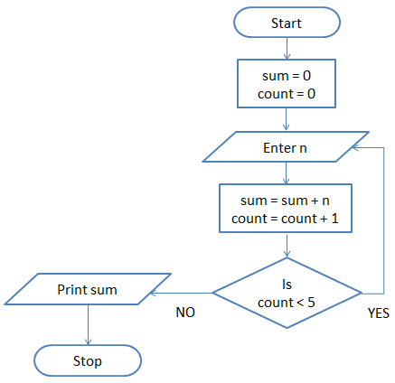
Task: Pseudocode
You have a worksheet full of flowcharts.
Complete the pseudocode for each flowchart.
Add Python code for each – if you know another language add examples with that, e.g. javascript or C#
Complete all worksheets.
Start on the “ongoing project”
Flowchart | Pseudocode | Python | Js/C#
Notes:
This is a while loop and is confusing – degree lot should be ok with it

